Slide 1
Project launch example
Kishari Sing, Sr. Technical Partner & Product Marketing Manager
(Please note that confidential info has been stripped)

Slide 2
Agenda
Launch first AI solution for the company
  Leverage company branding and data management features for credibility
  Fit within existing portfolios yet differentiate for new division
Highlight partnership and co-launch with NVIDIA
Leverage first-mover advantage:
  Carve out differentiation for industry, for sales teams, against competitors
Two persona tiers to target simultaneously
  Intro: existing AI infrastructure community for industry creds
  Update: HPC community for NetOps/AIOps
Capture as much customer research as possible during launch window

Slide 3
Launch first AI solution
Product name options were presented through product and exec teams to fit within branding guidelines, but also differentiate AI usage
Reference architecture in development with NVIDIA for (NVIDIA Cloud Partners) participation
Differentiators leaned heavily on Company data management/network infrastructure capabilities

Slide 4
Highlight partnership with NVIDIA
NVIDIA to launch an announcement on their website
At the same time, Company to launch announcement via press release or blog post
To be presented together at NVIDIA GTC event in India
  No fireside chats available, but booth signage and hardware shared
  Early customers were invited to meet at GTC

Slide 5
Positioning: for First Mover advantage
Staked out the “Maximize GPU performance in your network infrastructure at scale” positioning
  Unique company function: solution offloads slow CPU compute to NVIDIA DPU (BlueField-3), which accelerates NVIDIA GPU parallel processing
  DPUs already included in most NVIDIA pods but requires activation
  Competitive analysis (and informal customer inquiry) indicated this capability did not yet exist elsewhere.
  Kubernetes expertise is lacking, Company is providing a significant solution.
Set the performance bar high for competitors when they catch up
Early customer use cases highlighted:
  AI model LLM for an EU government
  Sovereign Digital Infrastructure for DC/AI/Cyber in India

Slide 6
Two persona tiers for launch
Primary: AI infrastructure decision makers—launch at AI Expo
  Business and technical decision makers at reputable show
  Already familiar with the company, understand value prop for new application
  Built-in trust for network security as well
  NVIDIA added industry cred
Second: High performance compute decision makers—in HPC Wire
  Prospects already performing these functions, introducing Company into consideration mix
  Less branding, more performance messaging
    Content marketing (article) plus ROS ads for awareness

Slide 7
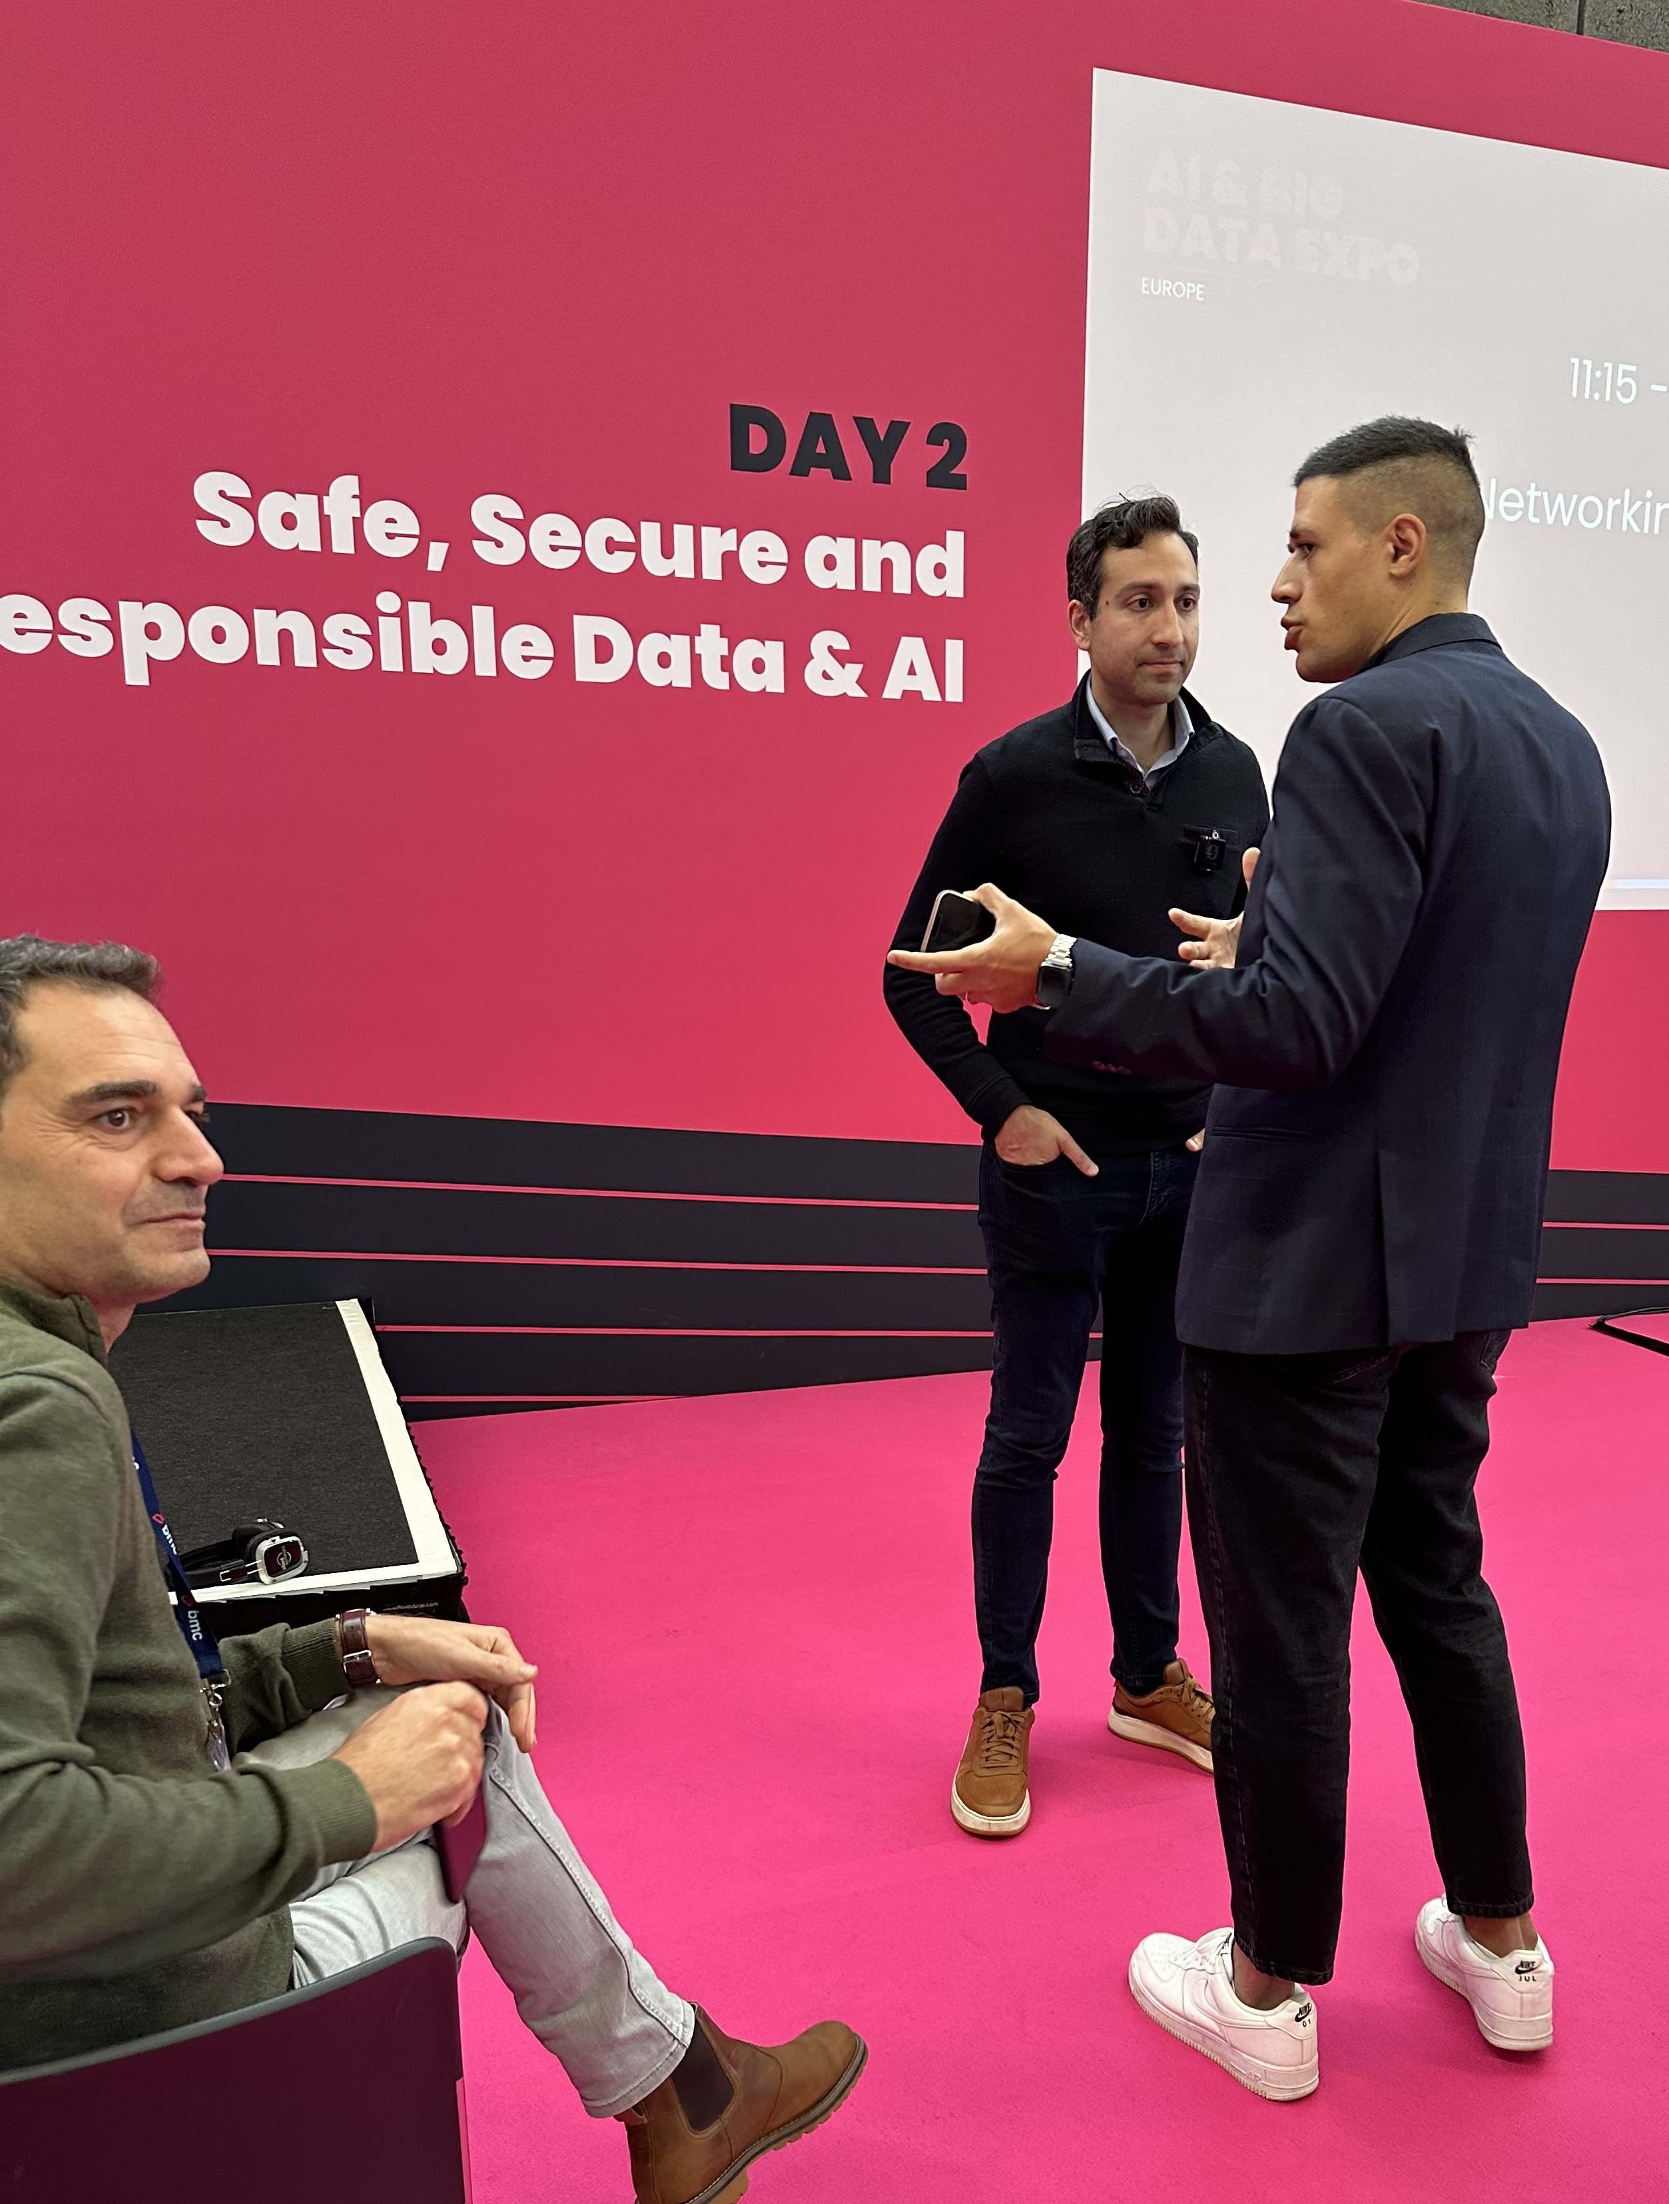
CTO/CIO Keynote for primary target at AI Expo, Amsterdam

Slide 8
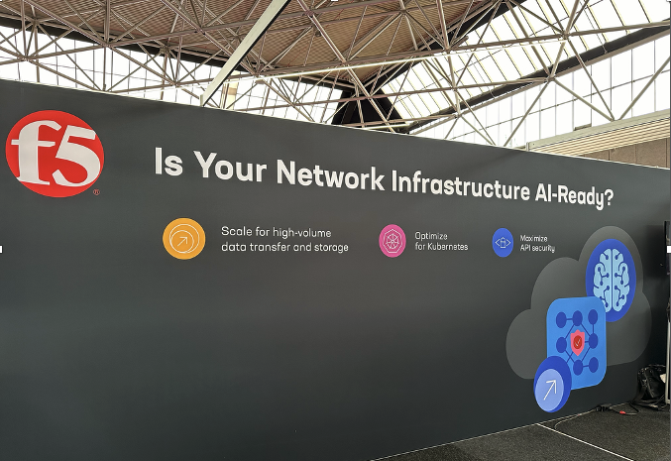
High level intro copy at AI Expo

Slide 9
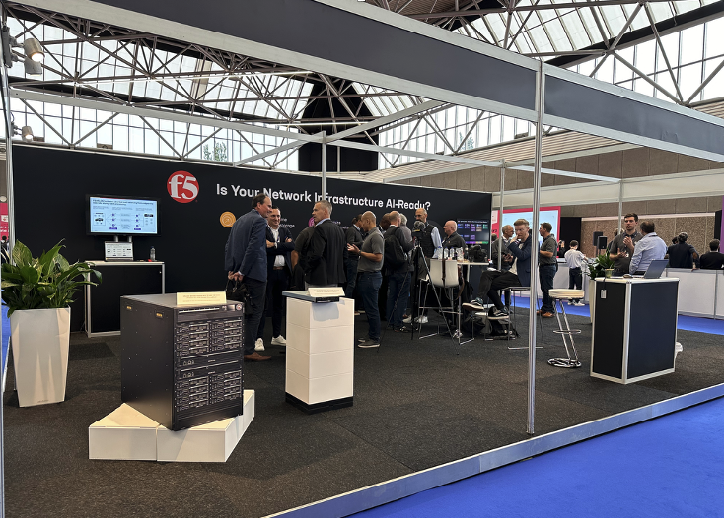
Booth with hardware, software stack demos

Slide 10
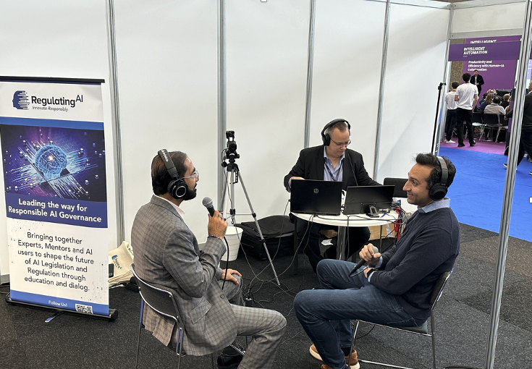
Exec interviews onsite at AI Expo

Slide 11
“Bridging infrastructure gaps to accommodate AI growth” launch content
HPCWire sponsorship to target secondary NetOps/AI Ops audience: article, ads, lead gen
https://www.hpcwire.com/2024/09/30/bridging-the-infrastructure-gaps-to-accommodate-skyrocketing-ai-growth/
For industry awareness and initial sales enablement messaging

Slide 12
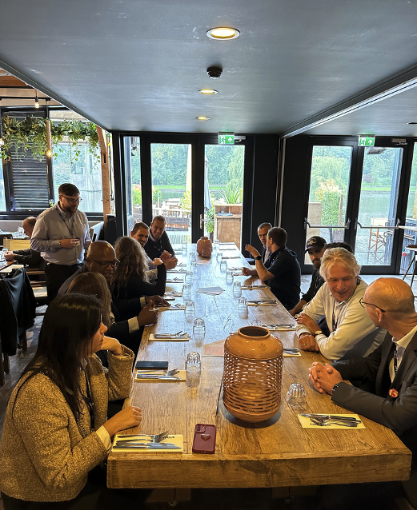
Gather customer input
In addition to customers/prospect, we sponsored an onsite exec lunch to targeted attendees

